Slide 1
Applied Phyogenetics EEBL 606 20 Feb 2019 Heath Blackmon

Slide 2
Systematics in 21st C?
Taxonomy
Nomenclature
Evolutionary Relationships
Classification
Character evolution

Slide 3
Today: Applied phylogenetics
Applied Phylogenetics
Character evolution
Morphology
Genes/Networks
Diversification analysis
Biogeographic analysis

Slide 4
Today: Applied phylogenetics
Applied Phylogenetics
Character evolution
Morphology
Genes/Networks
Diversification analysis
Biogeographic analysis

Slide 5
Common Questions
Does the evolution of one trait impact the evolution of a second trait?
Do different types of changes in a trait happen with equal frequency?
Is a certain value of a trait “best”?
Does a trait impact the diversification of a group of organisms

Slide 6
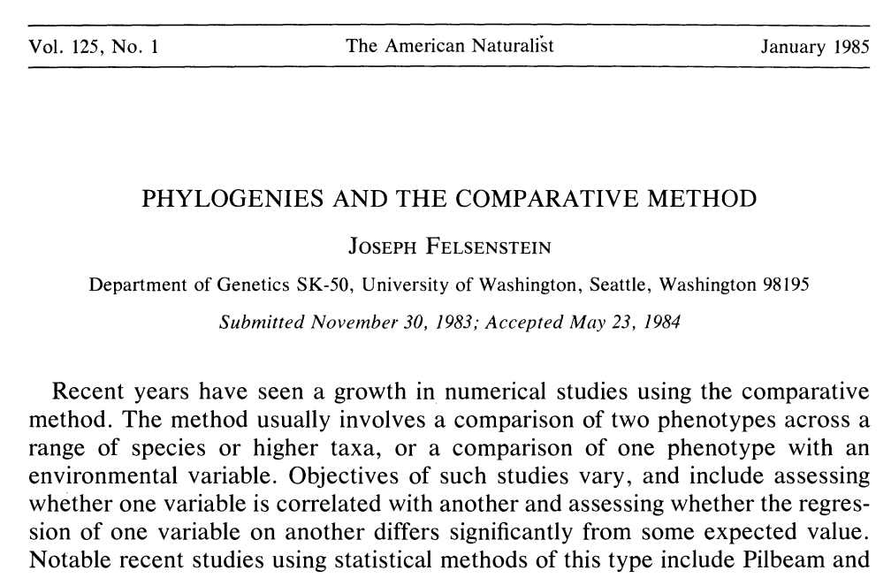
The Challenge for understanding trait evolution
Species are not independent points! They share an evolutionary history including millions of years when their traits were evolving in a single ancestral lineage.
dice

Slide 7
Types of Methods (traits)
Analyzing the tempo and mode of trait evolution
Continuous Traits
Discrete Traits
Correcting for phylogeny

Slide 8
Types of Methods (traits)
Continuous Traits:
Brownian Motion
R: ape, geiger
OU models
R: ouch, geiger
Rate shift models
R: BAMM
Sometimes people discretize a continuous trait

Slide 9
Types of Methods (traits)
Discrete Traits
Markov Models
R: diversitree, ape, geiger
Threshold Models
R: phytools: also has great visualization tools
Paper for next weeks discussion

Slide 10
Types of Methods (traits)
Correcting for phylogeny
Independent Contrasts
Simulation Based approaches
Variance Covariance Matrices
R example

Slide 11
Diversification
Diversification: increase in the number of lineages through time - richness
Disparification: increase in the range of trait values in a clade through time - variance
Adaptive Radiation: diversification facilitated by new adaptive traits

Slide 12
Methods
Sister clade contrasts
Explicit model based approaches (BiSSE, BAMM, etc.)
LTT

Slide 13
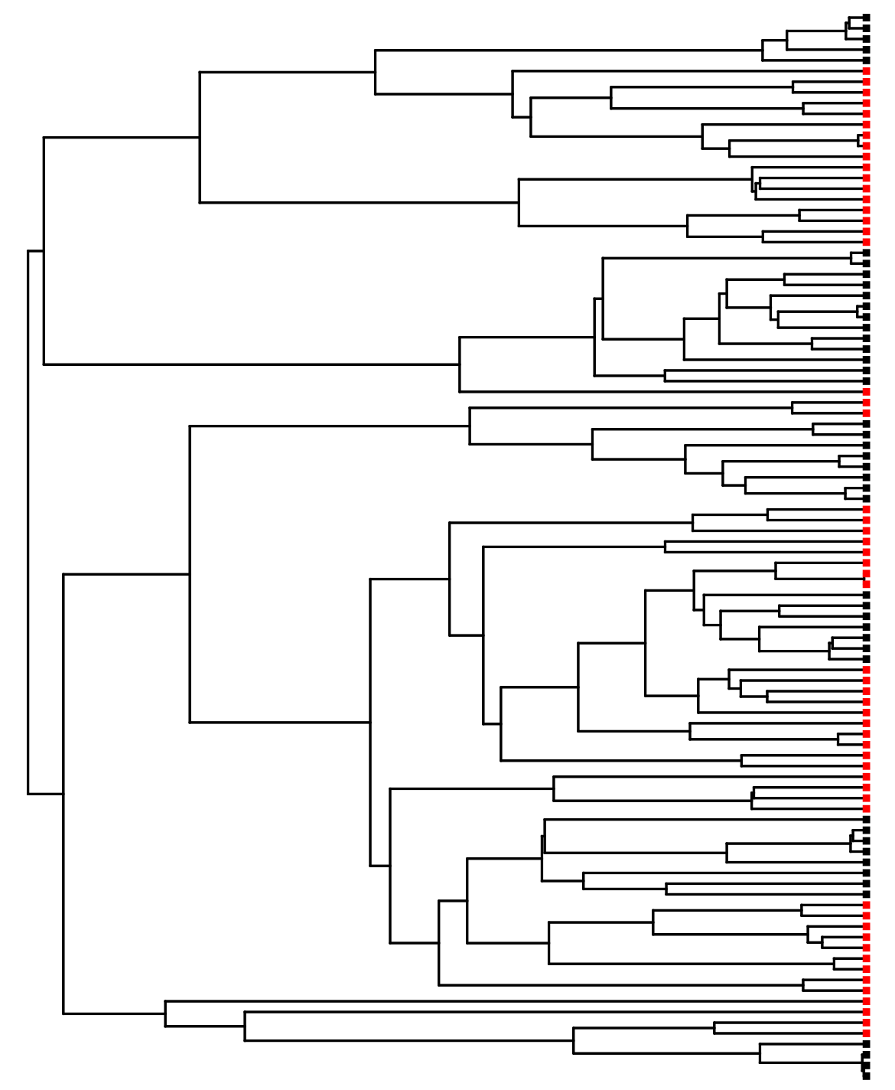
Sister clade contrasts

Slide 14
Sister clade contrasts

Slide 15
Sister clade contrasts
1
2
3
4
5
1
2
3
4
5
6
7
8
9

Slide 16
Sister clade contrasts

Slide 17
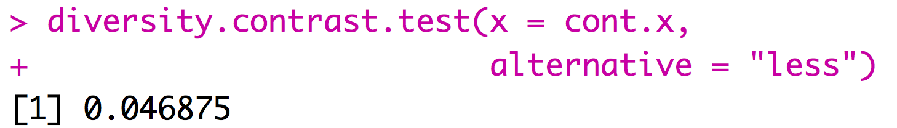
Sister clade contrasts
1
node | Red species | Black species
117 | 9 | 5
238 | 1 | 13
164 | 2 | 8
271 | 3 | 7
105 | 7 | 8
129 | 2 | 4
= cont.x
2
3
4
5
General rule need around 5 comparisons to get P < 0.05
Use R package APE or beware that some old methods still implemented
6

Slide 18
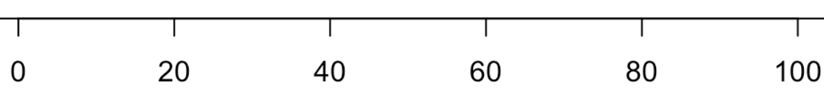
Problems with sister clade contrasts
time
Notes:
Draw it on the board

Slide 19
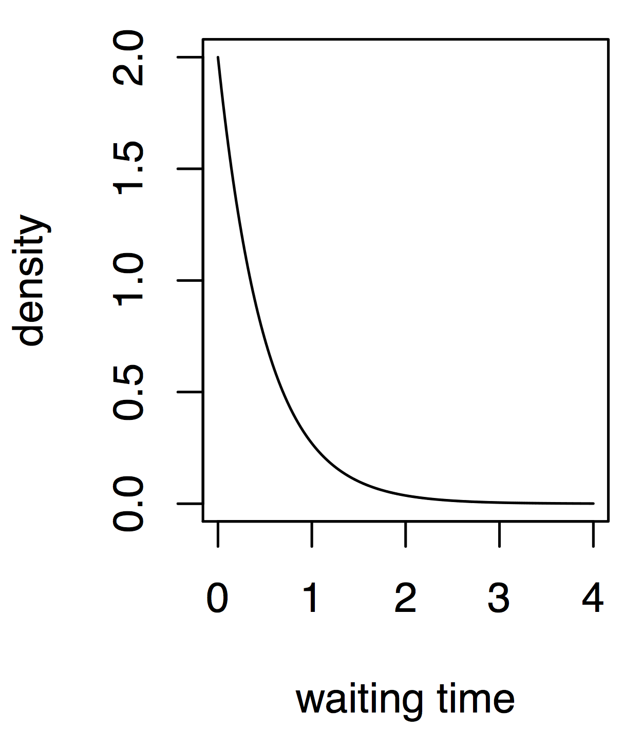
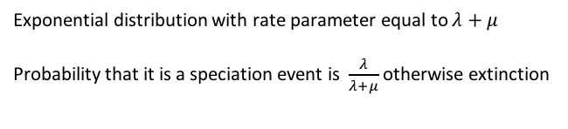
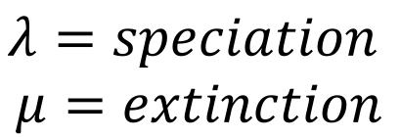
Explicit model based approach
$$λ=speciation$$
$$μ=extinction$$
Exponential distribution with rate parameter equal to $λ+μ$
Probability that it is a speciation event is $\frac{λ}{λ+μ}$ otherwise extinction

Slide 20
Explicit model based approach
$$λ=speciation$$
$$μ=extinction$$
Present
0.96
Exponential distribution with rate parameter equal to $λ+μ$
Probability that it is a speciation event is $\frac{λ}{λ+μ}$ otherwise extinction
4 3 2 1
Time before present

Slide 21
Explicit model based approach
$$λ=speciation$$
$$μ=extinction$$
Present
0.96
Exponential distribution with rate parameter equal to $λ+μ$
Probability that it is a speciation event is $\frac{λ}{λ+μ}$ otherwise extinction
4 3 2 1
Time before present

Slide 22
Explicit model based approach
$$λ=speciation$$
$$μ=extinction$$
Present
Exponential distribution with rate parameter equal to $λ+μ$
Probability that it is a speciation event is $\frac{λ}{λ+μ}$ otherwise extinction
4 3 2 1
Time before present

Slide 23
Explicit model based approach
$$λ=speciation$$
$$μ=extinction$$
Present
Exponential distribution with rate parameter equal to $λ+μ$
Probability that it is a speciation event is $\frac{λ}{λ+μ}$ otherwise extinction
4 3 2 1
Time before present

Slide 24
Explicit model based approach
$$λ=speciation$$
$$μ=extinction$$
Present
Exponential distribution with rate parameter equal to $λ+μ$
Probability that it is a speciation event is $\frac{λ}{λ+μ}$ otherwise extinction
4 3 2 1
Time before present

Slide 25
Explicit model based approach
$$λ=speciation$$
$$μ=extinction$$
Present
Exponential distribution with rate parameter equal to $λ+μ$
Probability that it is a speciation event is $\frac{λ}{λ+μ}$ otherwise extinction
4 3 2 1
Time before present

Slide 26
Explicit model based approach
$$λ=speciation$$
$$μ=extinction$$
Present
Exponential distribution with rate parameter equal to $λ+μ$
Probability that it is a speciation event is $\frac{λ}{λ+μ}$ otherwise extinction
4 3 2 1
Time before present

Slide 27
Explicit model based approach
$$λ=speciation$$
$$μ=extinction$$
Present
Exponential distribution with rate parameter equal to $λ+μ$
Probability that it is a speciation event is $\frac{λ}{λ+μ}$ otherwise extinction
4 3 2 1
Time before present

Slide 28
Explicit model based approach
$$λ=speciation$$
$$μ=extinction$$
Present
Exponential distribution with rate parameter equal to $λ+μ$
Probability that it is a speciation event is $\frac{λ}{λ+μ}$ otherwise extinction
4 3 2 1
Time before present

Slide 29
Explicit model based approach
$$λ=speciation$$
$$μ=extinction$$
Present
Exponential distribution with rate parameter equal to $λ+μ$
Probability that it is a speciation event is $\frac{λ}{λ+μ}$ otherwise extinction
4 3 2 1
Time before present
Notes:
Show it in R

Slide 30
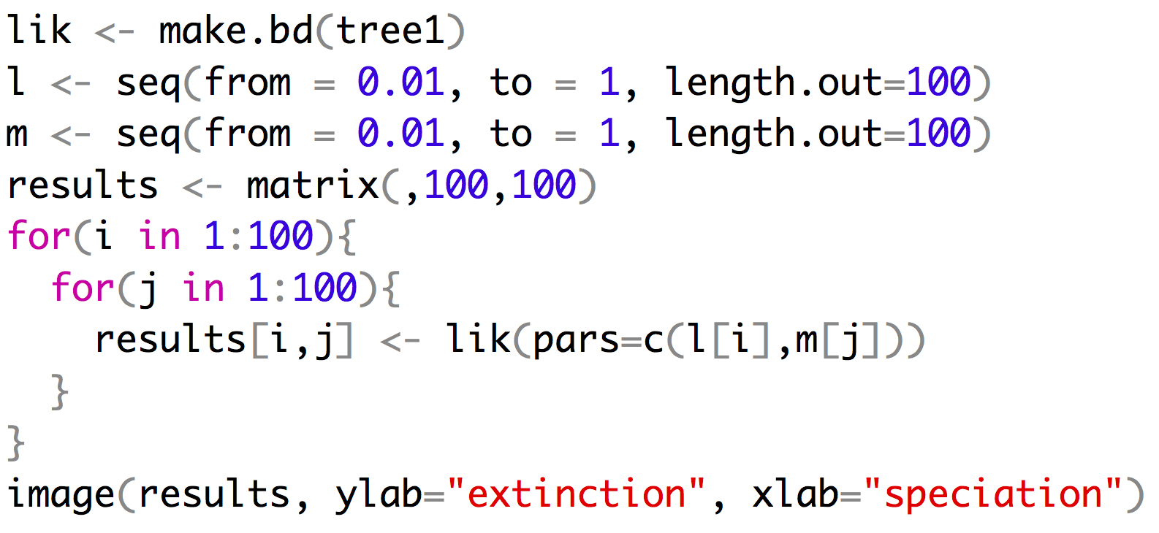
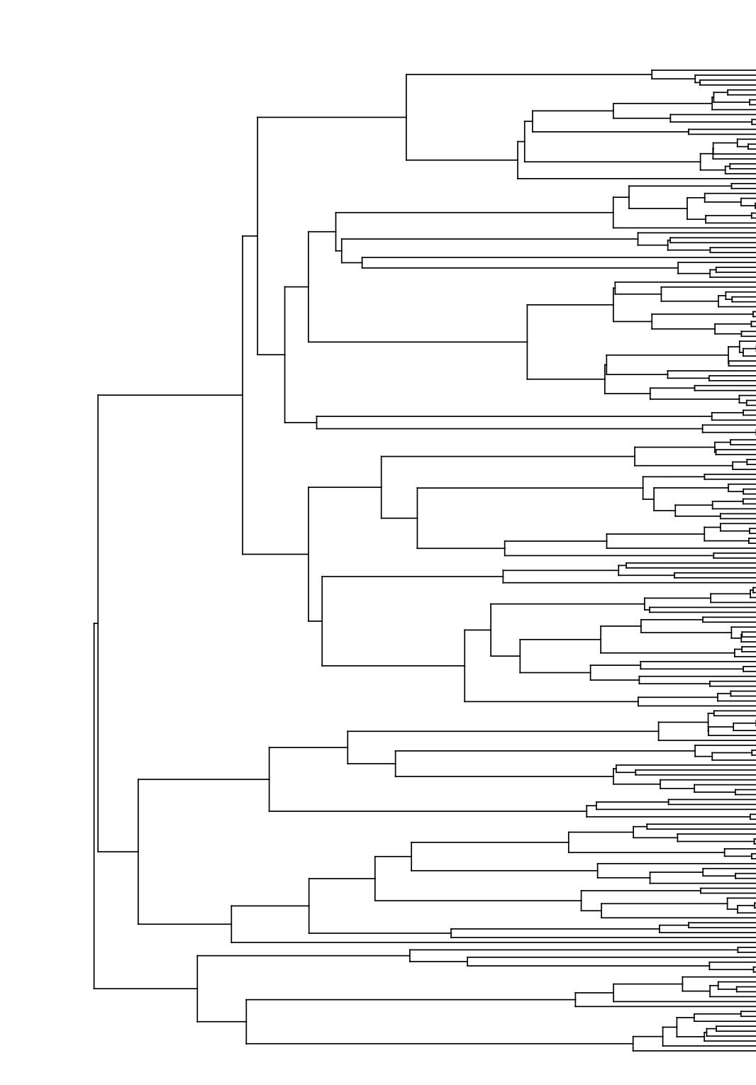
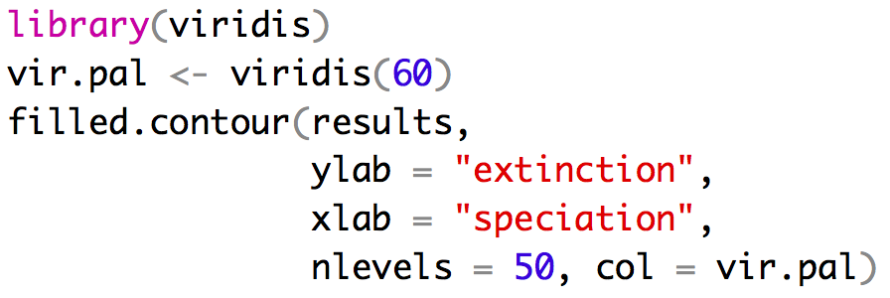
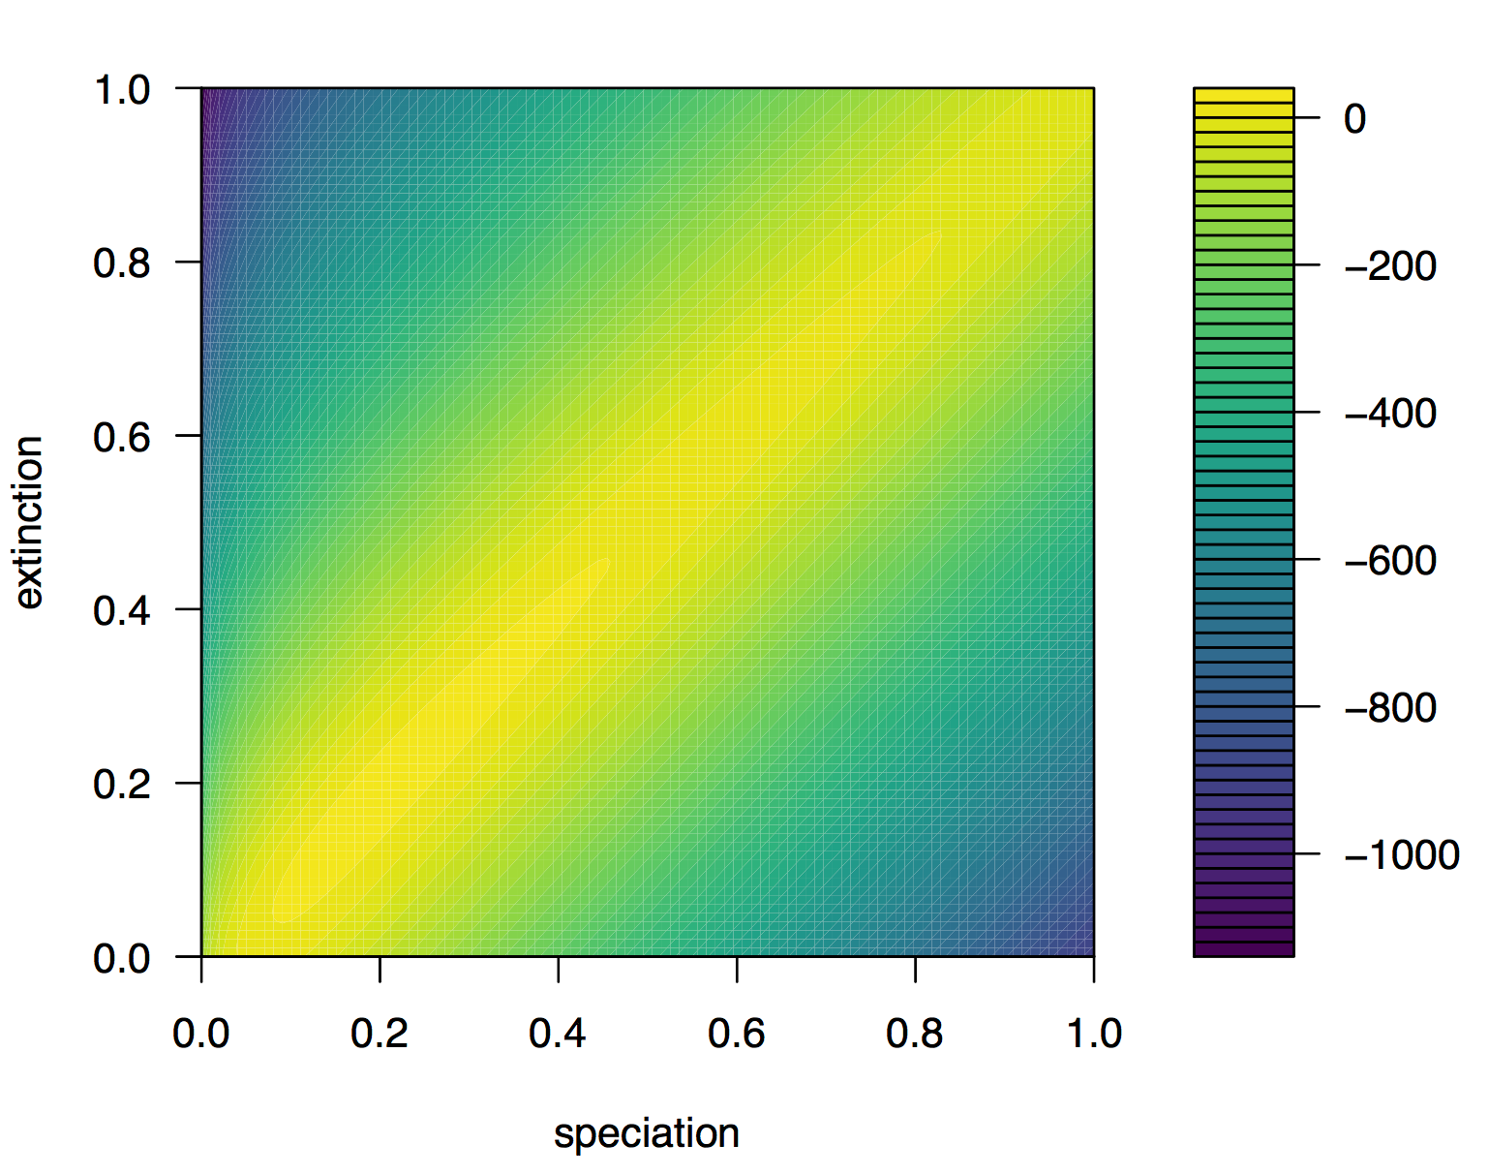
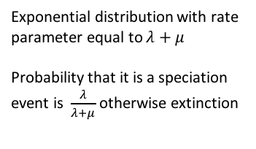
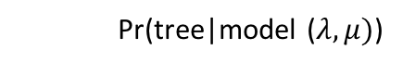
Explicit model based approach
$$λ=speciation$$
$$μ=extinction$$
Pr(tree|model ($λ,μ)$)
Exponential distribution with rate
parameter equal to $λ+μ$
Probability that it is a speciation
event is $\frac{λ}{λ+μ}$ otherwise extinction
True value

Slide 31
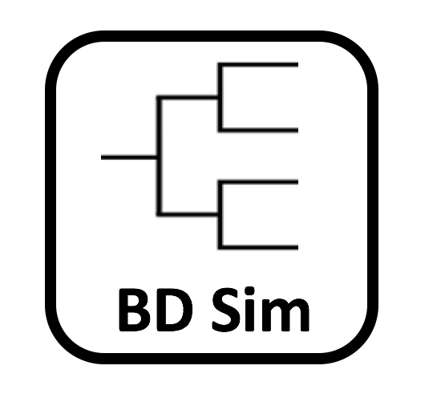
High Variance in species under the BD model

Slide 32
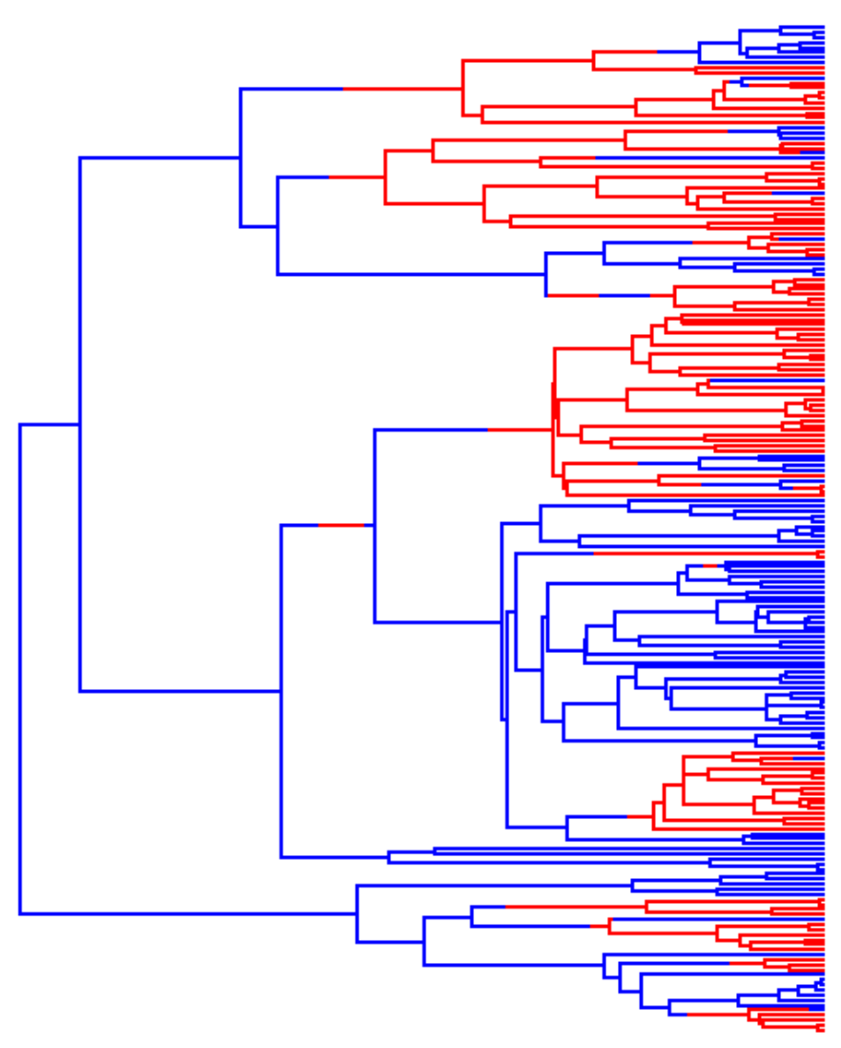
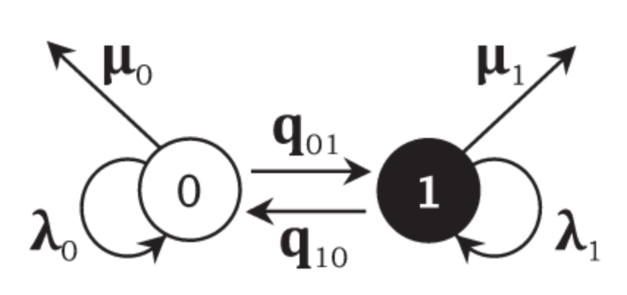
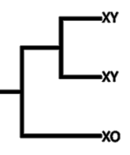

BiSSE
SSE = state dependent
speciation and extinction
This method has gone on to spur the development of many extensions
BiSSE
MuSSE
QuaSSE
GeoSSE
HiSSE
ChromeTrait

Slide 33
BiSSE
Despite the desire people have to use BiSSE(and extensions) it has some problems.
- pseudoreplication
- many/most empirical trees contain the signature of rate variation
Rabosky and Goldberg 2015 does a nice job of explaining problems with BiSSE type models
One popular alternative is/was BAMM but there are problems

Slide 34
My Advice
If you are interested in diversification.
Use more than one method
Play with priors and compare your results with very different priors
If you use BAMM and find the same rate shifts regardless of the prior that you use some reviewers will accept your results.
If you can also show that these results are consistent with other approaches to analyzing your data more reviewers will accept your results.

Slide 35
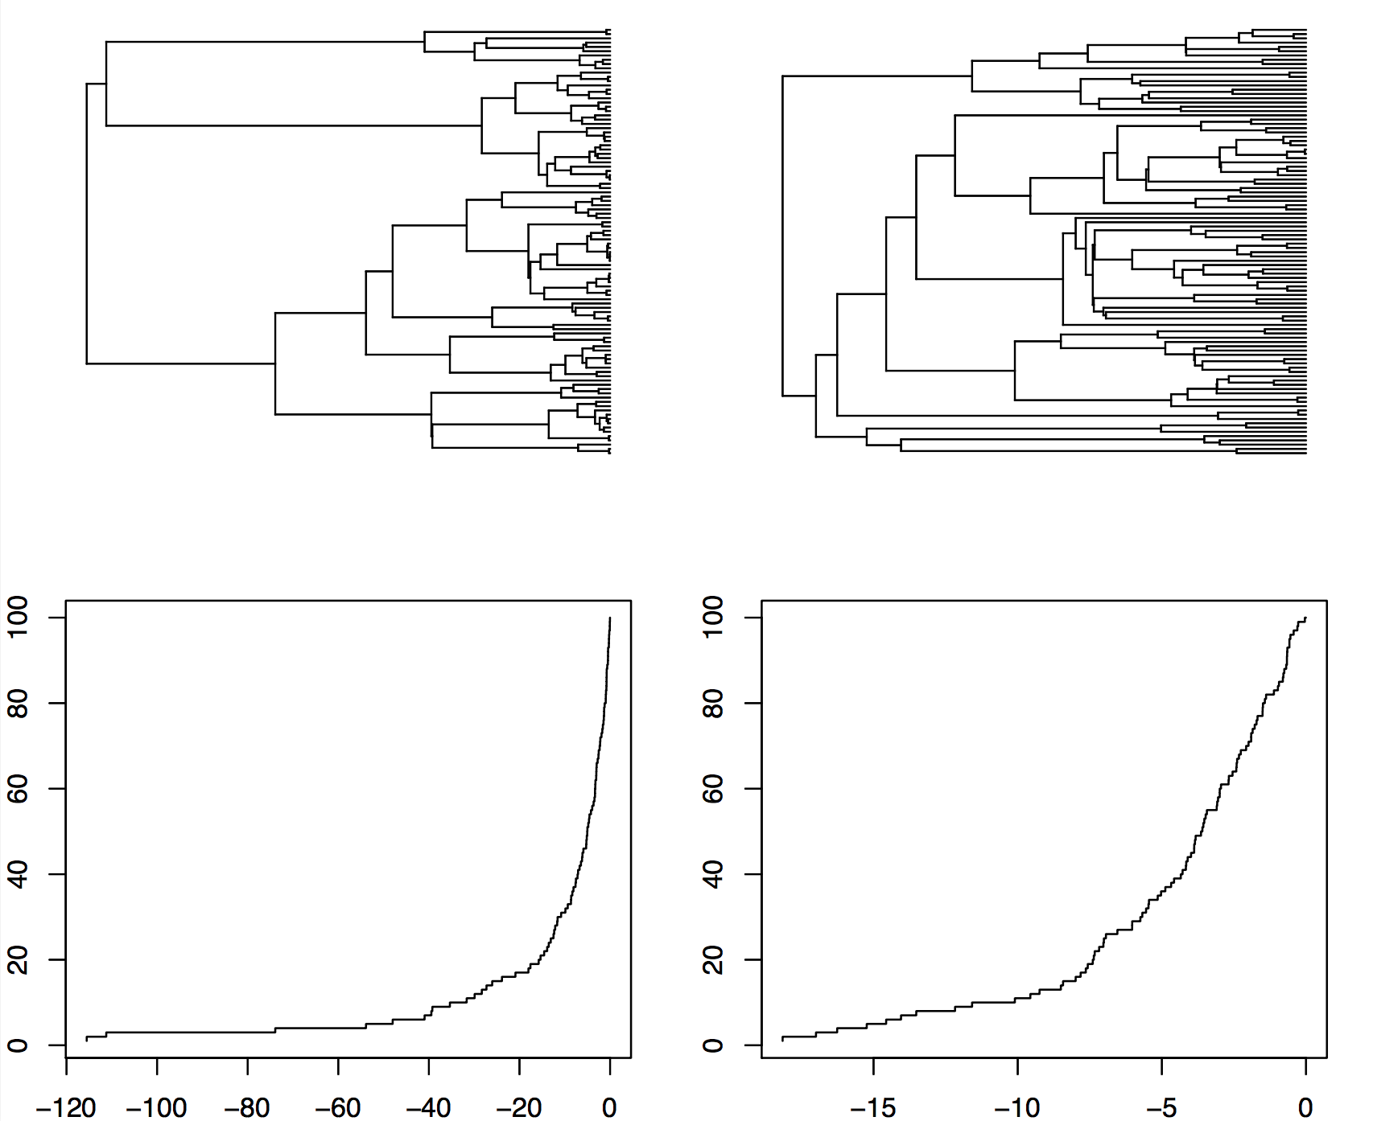
LTT Plots
If we assume a birth death model the large uptick in an LTT plot as we reach the present day is caused by sampling lineages that are likely to go extinct in the future.
Pull of the present

Slide 36
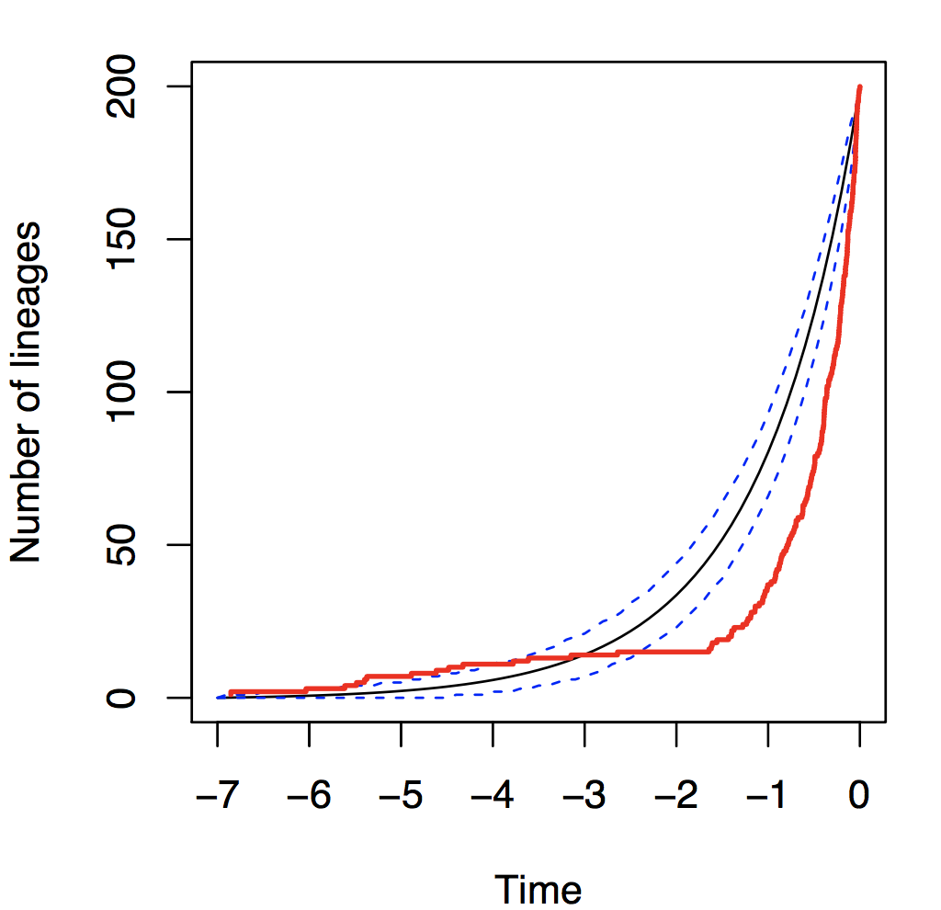
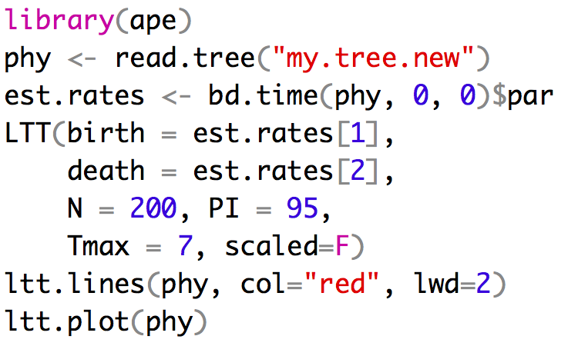
LTT Plots are put to many uses

Slide 37
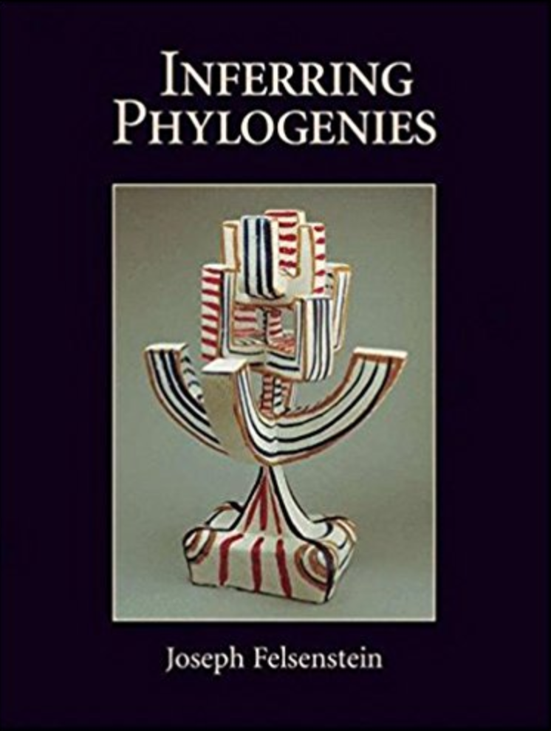
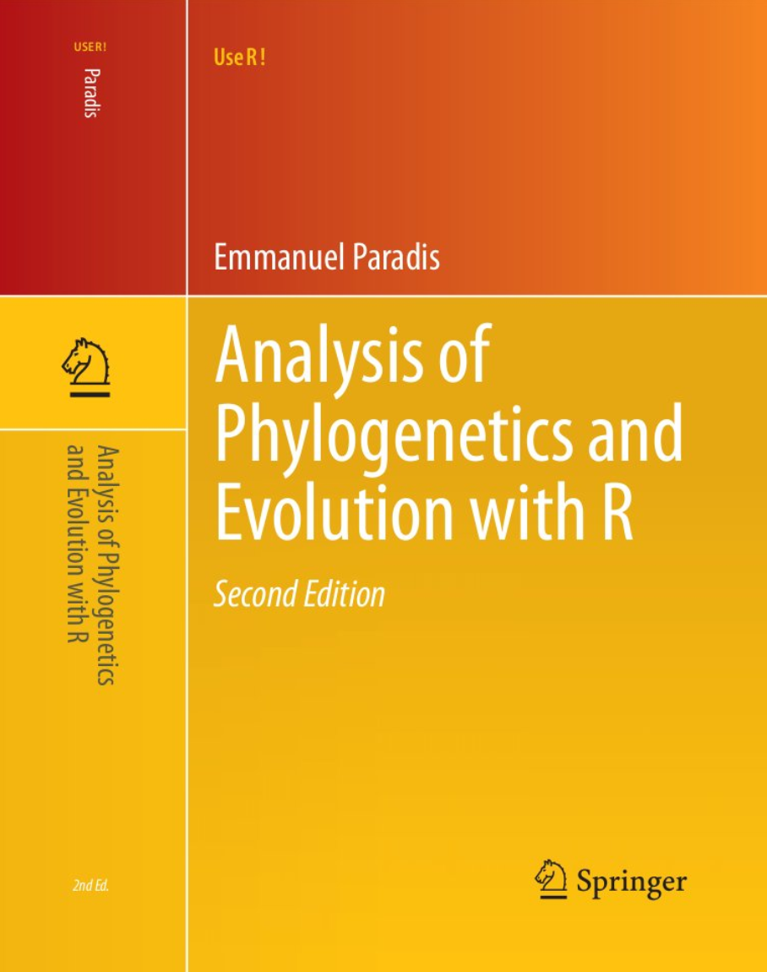
Take homes
Differential diversification analyses are hard!
The number of comparative methods available is constantly growing.
You can answer cool questions with comparative approaches!
My door is always open
CRAN Taskview
Workshops
Bodega – Bayesian/cheap
MBL – More molecular/very expensive

